Slide 1
TwinStrand Panel – v5
3/19/2021
Jason Kunisaki

Slide 2
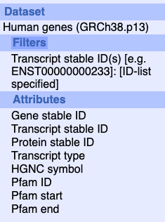
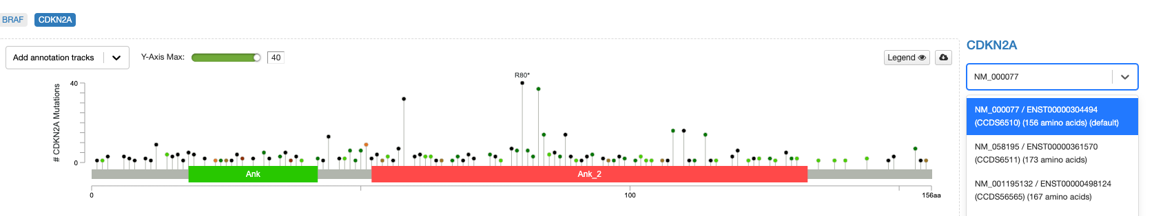
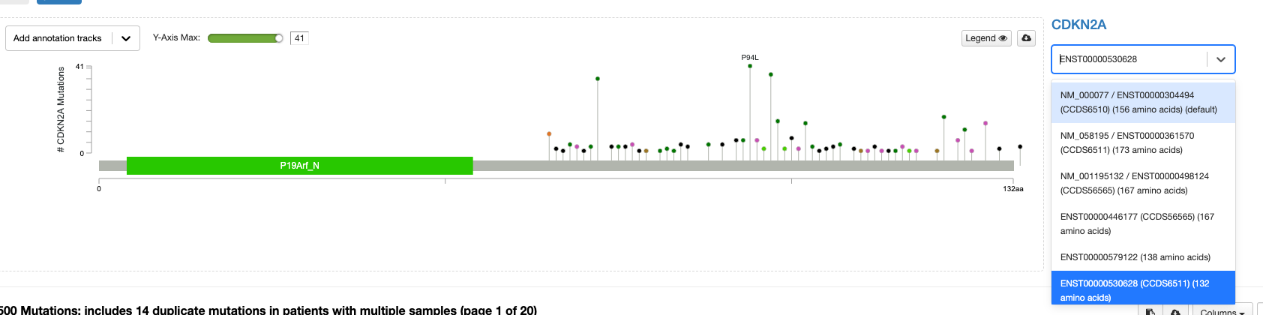
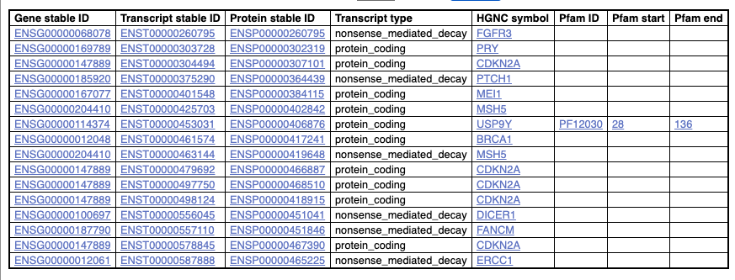
Caveat 1: CDKN2A has no functional domains in ensemble 102 but has functional domains in cBioPortal
Notes:
http://nov2020.archive.ensembl.org/biomart/martview/62b6fe8bb555adffeac01f7197937b88
Use uniprot to look for these genes

Slide 3
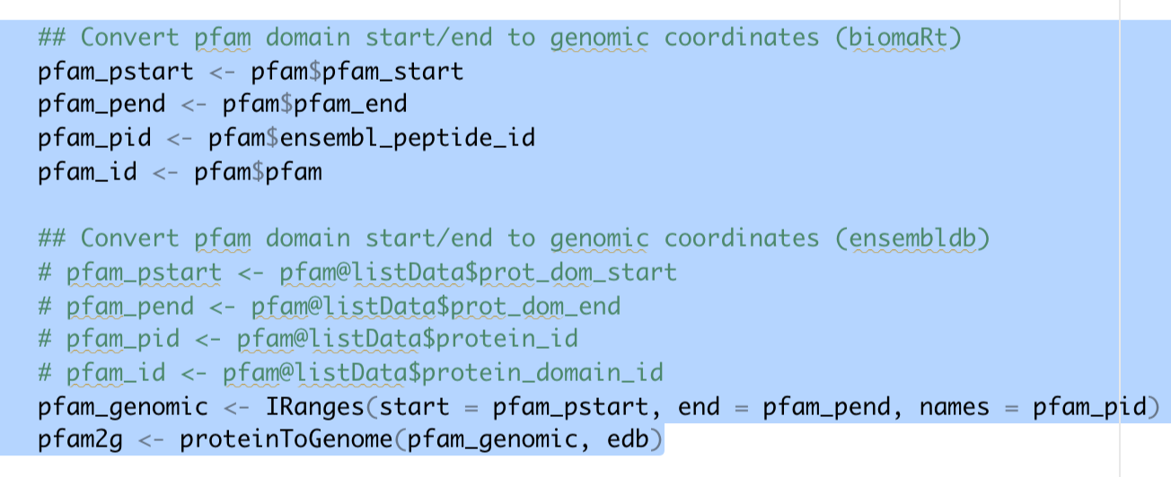
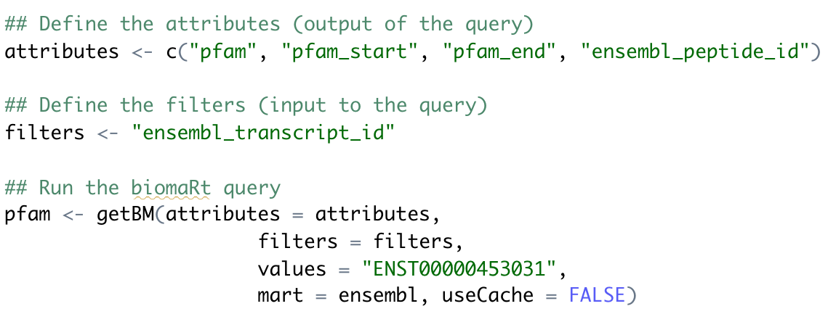
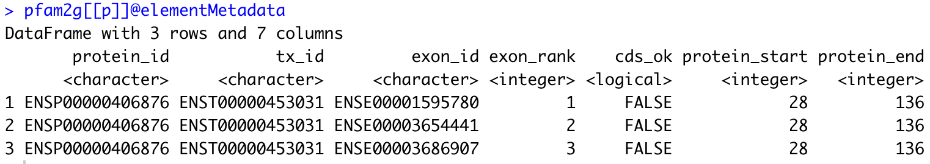
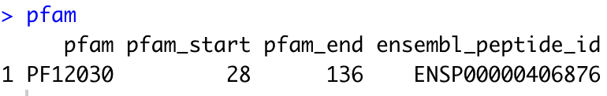
Caveat 2: Pfam domains locations are in protein coordinates → difficulty when mapping to genomic coordinates
How I dealt with this:
1) ignored the pfam domain within this transcript
2) Use jvarkit
Notes:
Use cBioPortal and see if the pfam id

Slide 4
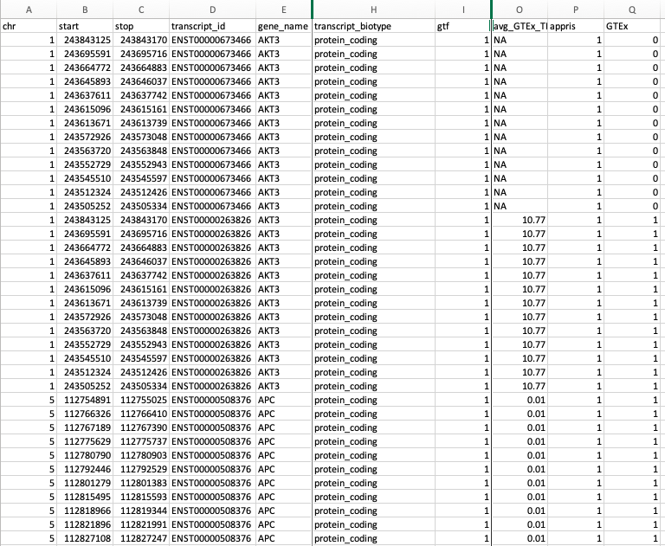
Caveat 3: Applied filters to select for … (see below)

Slide 5
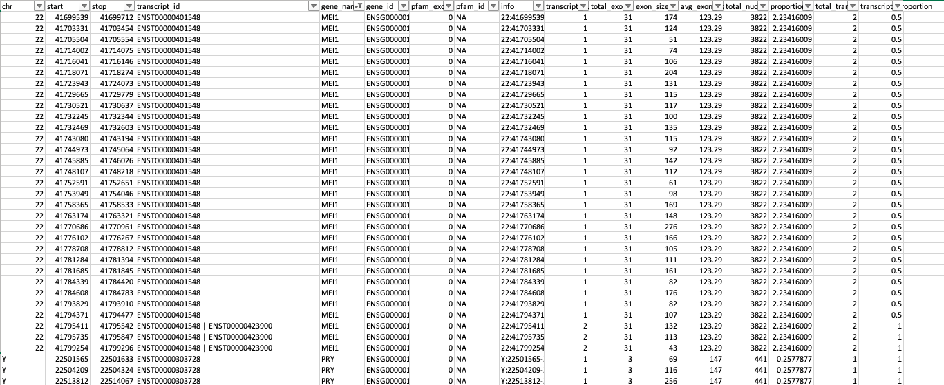
Caveat 4) Add 4,200 to the total panel size to account for entire CDS of MEI1 and PRY

